Slide 1
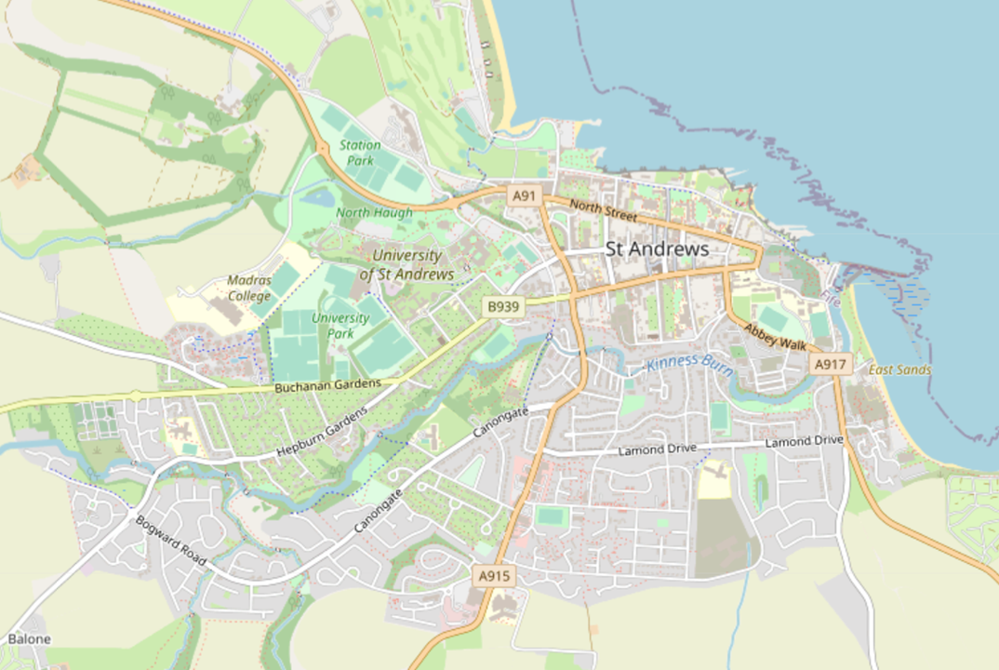
© OpenStreetMap contributors ​
http://www.openstreetmap.org/copyright​

Slide 2
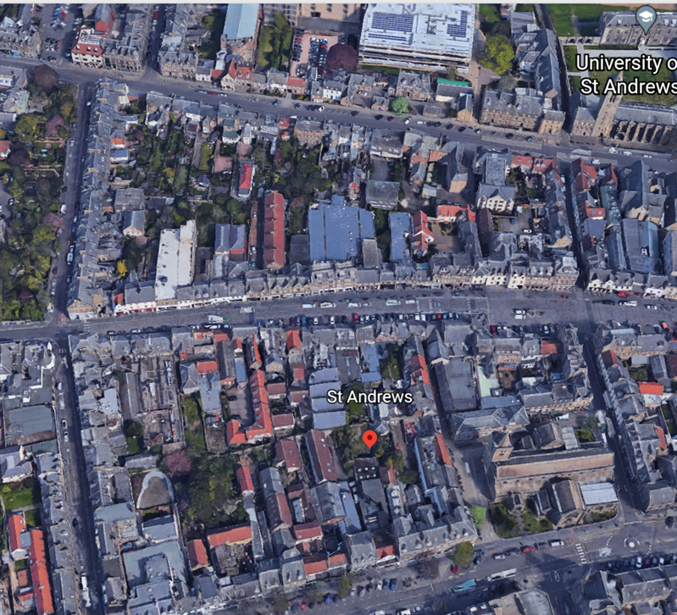
©Google Earth Google Earth

Slide 3
© OpenStreetMap contributors ​
http://www.openstreetmap.org/copyright​

Slide 4
© OpenStreetMap contributors
http://www.openstreetmap.org/copyright
Notes:
Example

Slide 5
Original lithographic print published in Charles Roger, History of St Andrews (Edinburgh: Adam & Charles Black, 1849).

