Slide 1
Blueprinting Activity Presentation – History of Photography
VIP St Andrews Team 2021 Jess and Emma

Slide 2
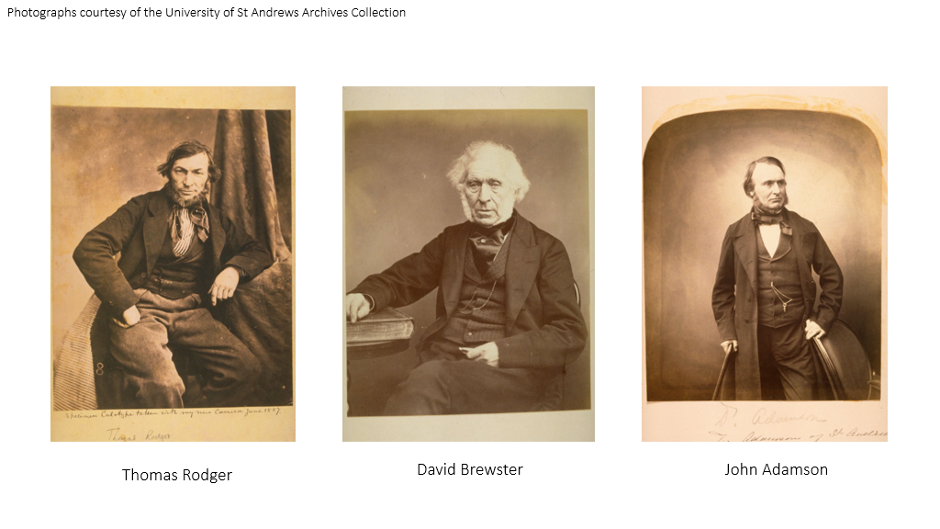

Slide 3
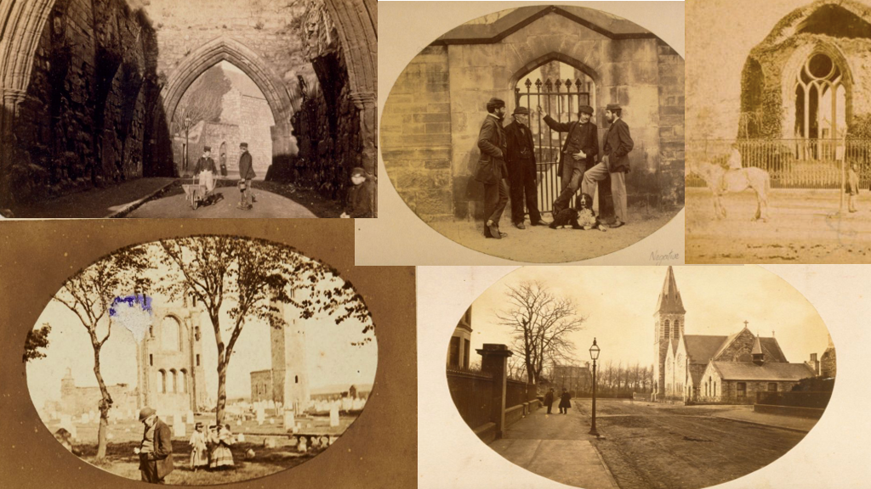

Slide 4
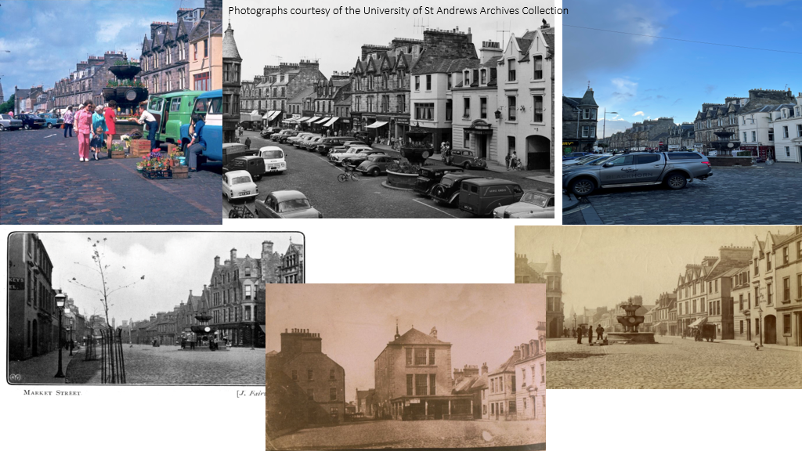

Slide 5
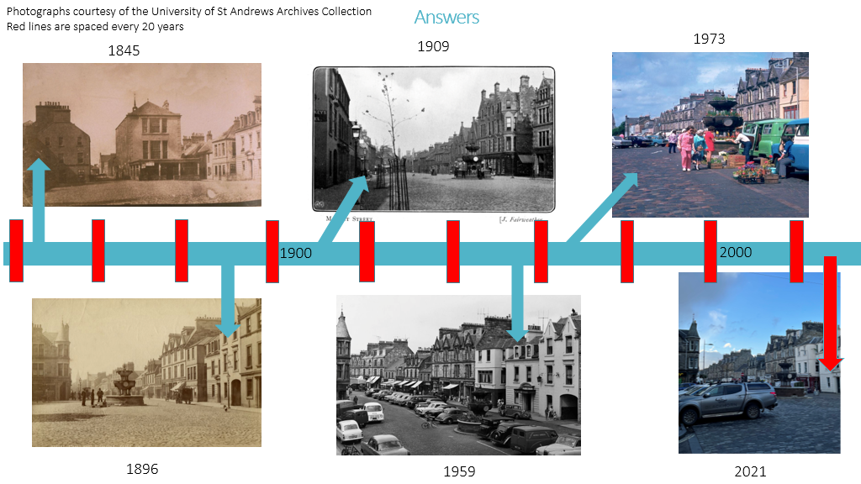

Slide 6
Extension Activity
https://special-collections.wp.st-andrews.ac.uk/2019/10/30/st-andrews-then-and-now-a-rephotography-project-part-v/
https://special-collections.wp.st-andrews.ac.uk/2019/10/16/st-andrews-then-and-now-a-rephotography-project-part-iii/
https://special-collections.wp.st-andrews.ac.uk/2019/10/09/st-andrews-then-and-now-a-rephotography-project-part-ii/
https://special-collections.wp.st-andrews.ac.uk/2019/10/02/st-andrews-then-and-now-a-rephotography-project-part-i/
https://special-collections.wp.st-andrews.ac.uk/2019/10/23/st-andrews-then-and-now-a-rephotography-project-part-iv/

