Slide 1
Thomas Rodger
Photograph courtesy of the University of St Andrews Archives Collection

Slide 2
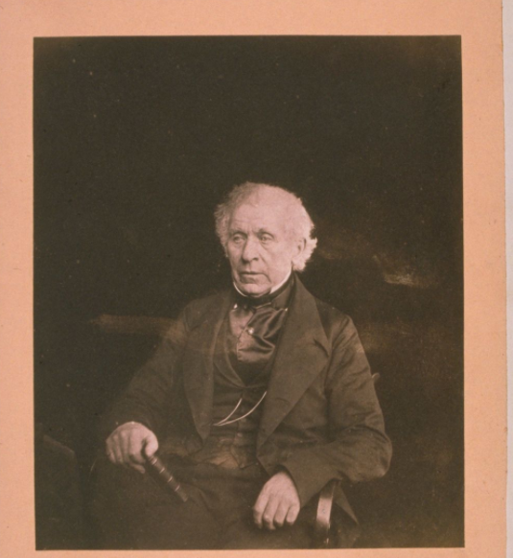
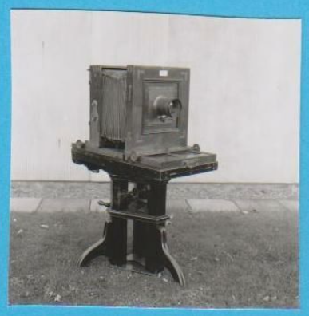
Photographs courtesy of the University of St Andrews Archives Collection
Notes:
Left: A calotype portrait of David Brewster
Right: A camera like the one Thomas Rodger would have used

Slide 3
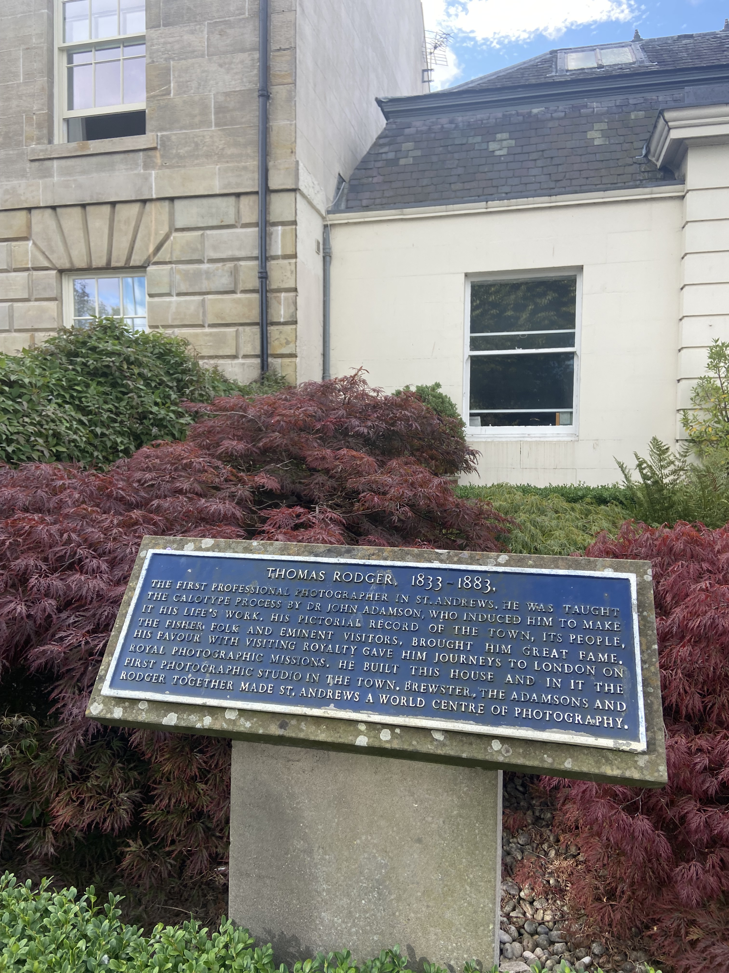
Notes:
Thomas Rodger’s photography studio today

Slide 4
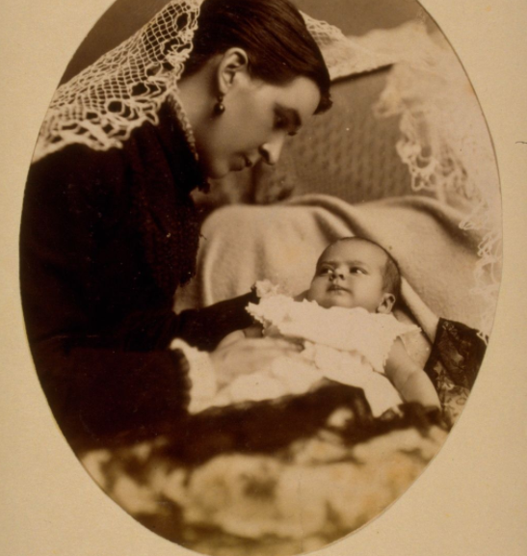
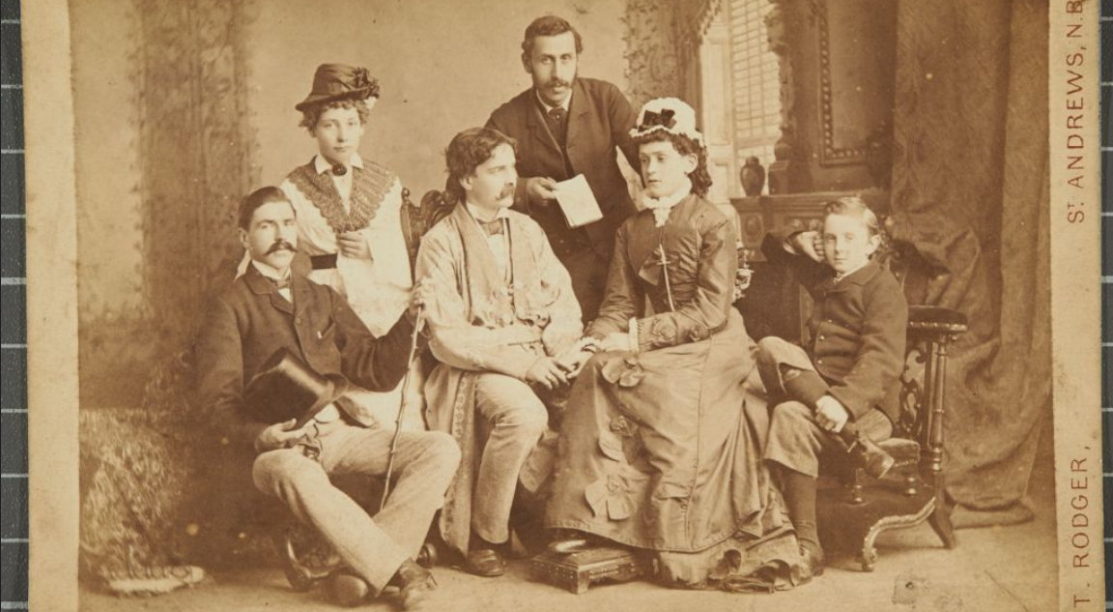
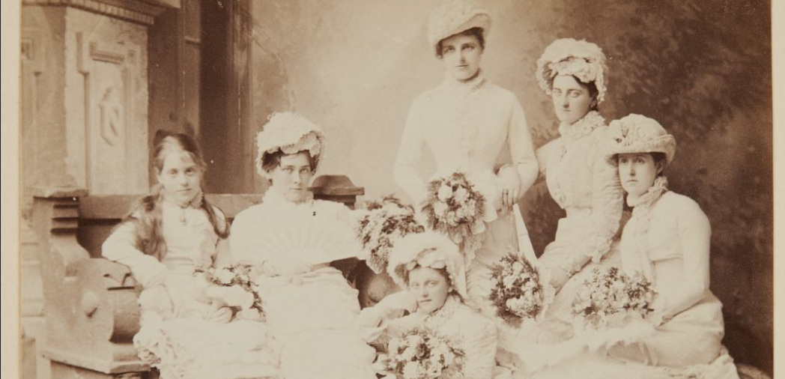
Photographs courtesy of the University of St Andrews Archives Collection
Notes:
Examples: w hy would people get their photos taken?

Slide 5
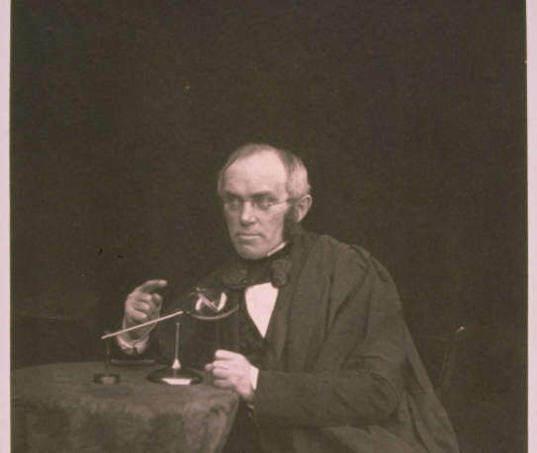
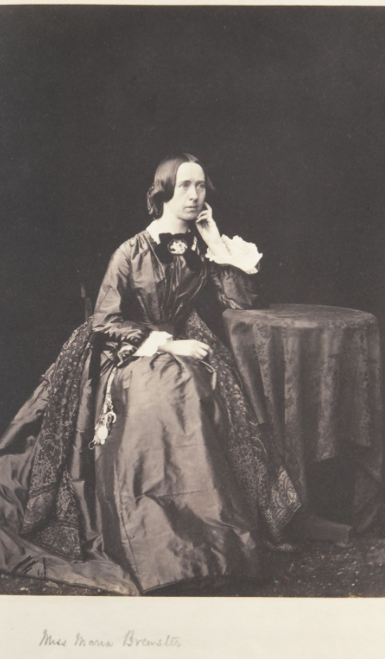
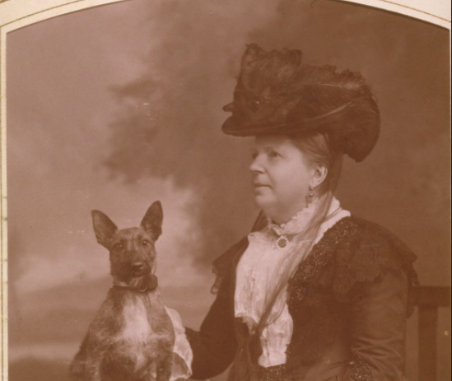
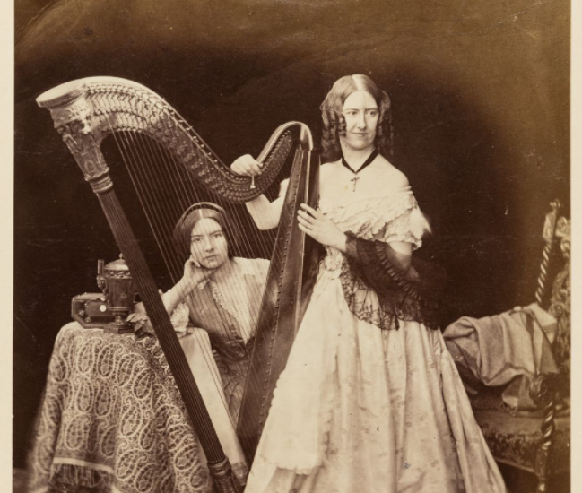
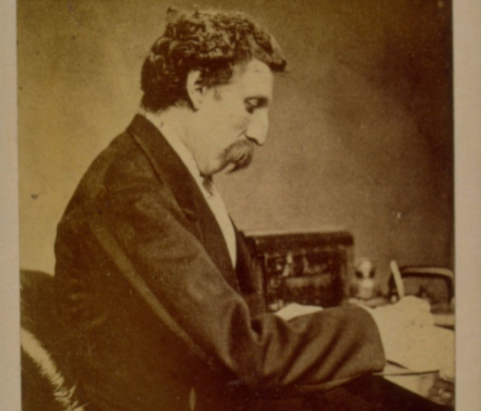
Photographs courtesy of the University of St Andrews Archives Collection
Notes:
Examples: Whole class portrait analysis

