Slide 1
Collage Activity Presentation – History of Photography
VIP St Andrews Team 2021 Jess and Emma

Slide 2
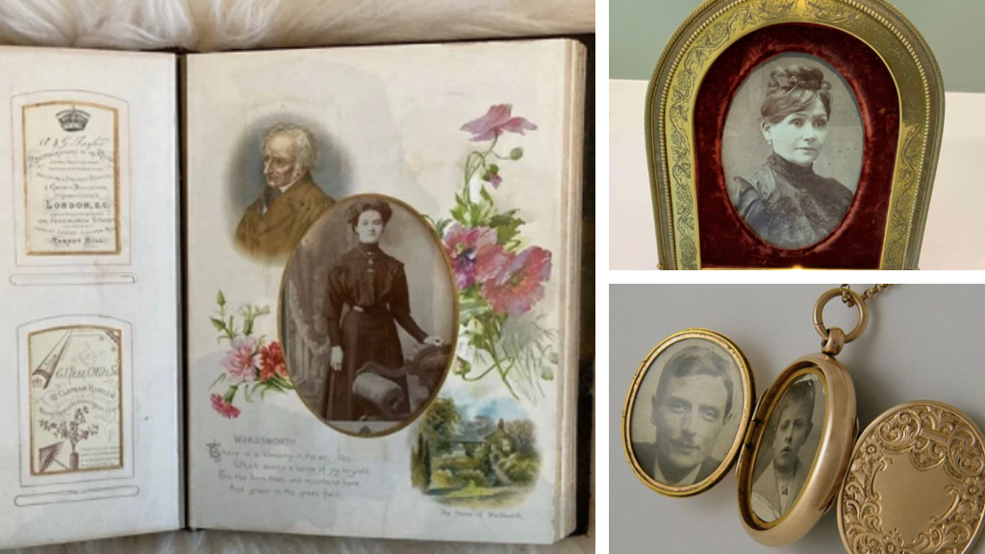
Picture sources can be seen in the presentation notes

Slide 3
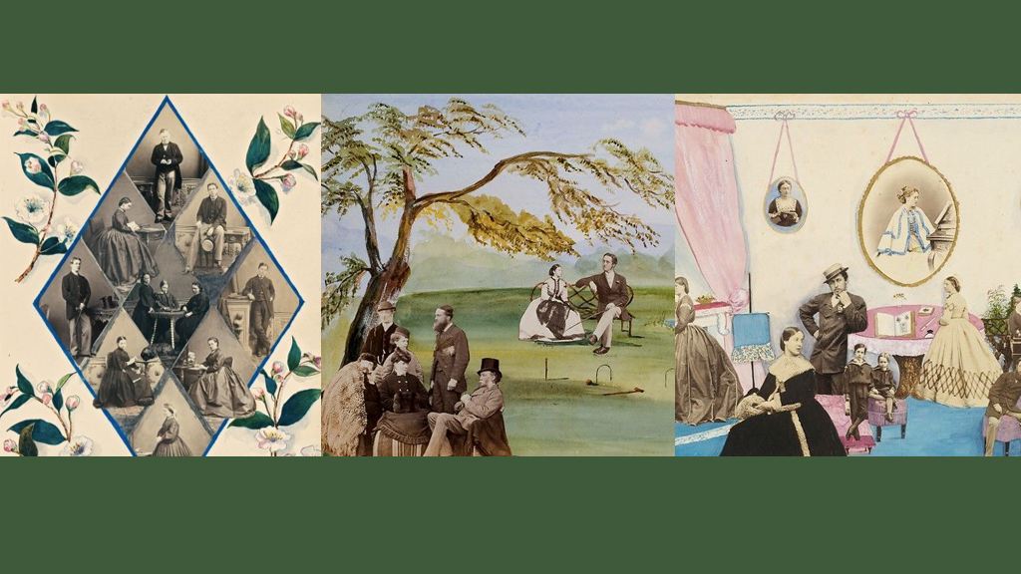
Pictures from the Met Gallery Collection

Slide 4
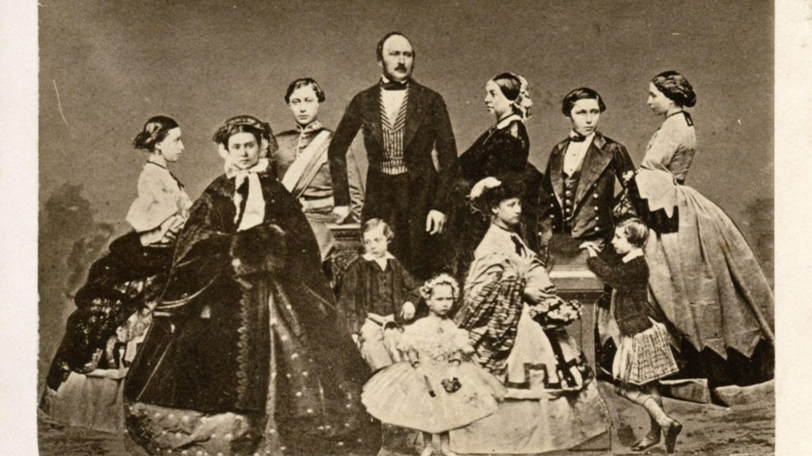
Picture from the St Andrews Archives

Slide 5
Picture sources can be seen in the presentation notes

