Slide 1
Blueprinting Activity Presentation – History of Photography
VIP St Andrews Team 2021 Jess and Emma

Slide 2
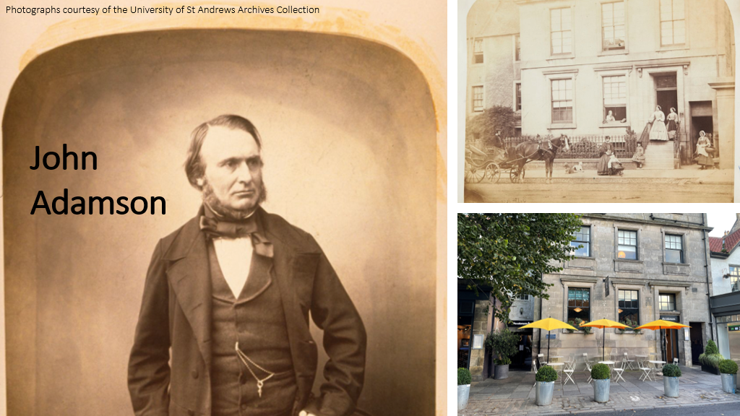

Slide 3
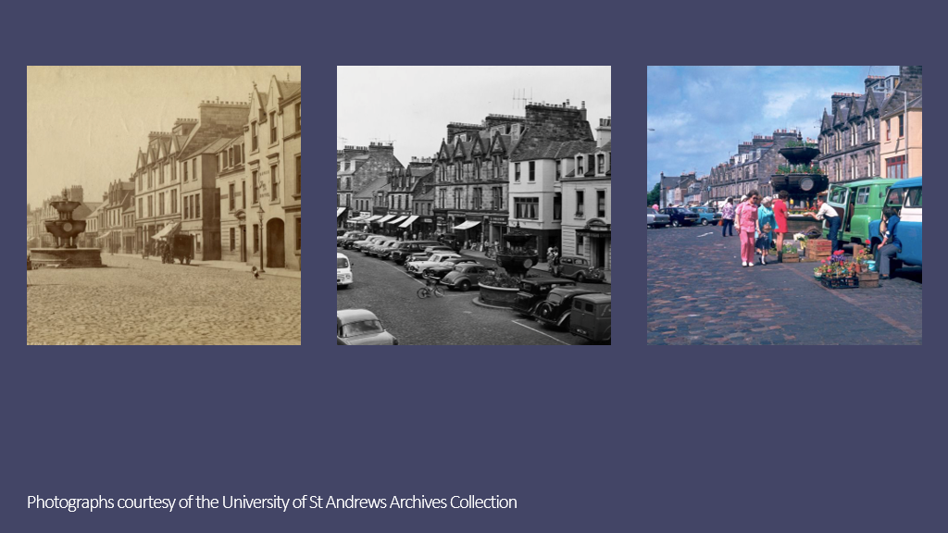

Slide 4
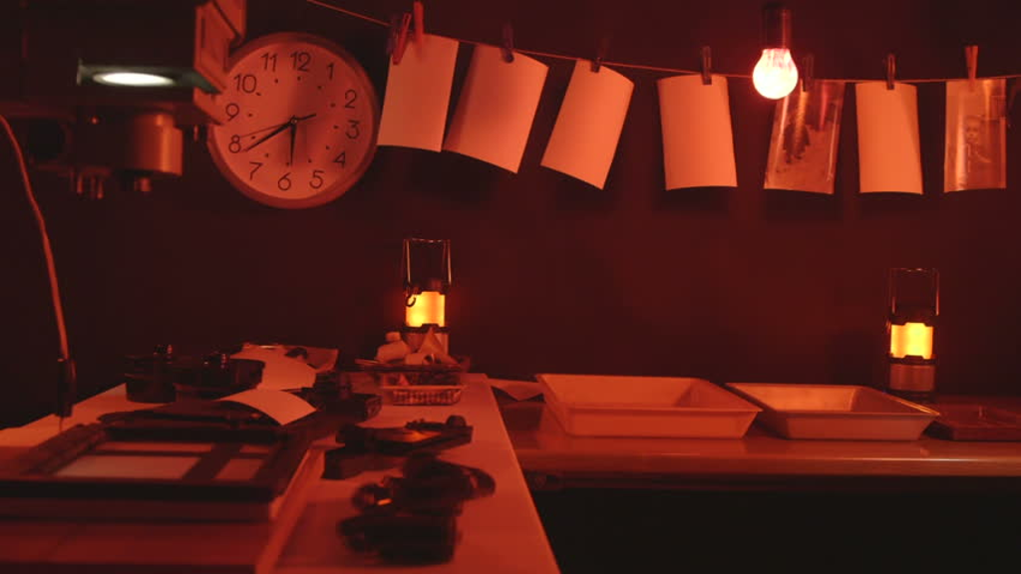

Slide 5
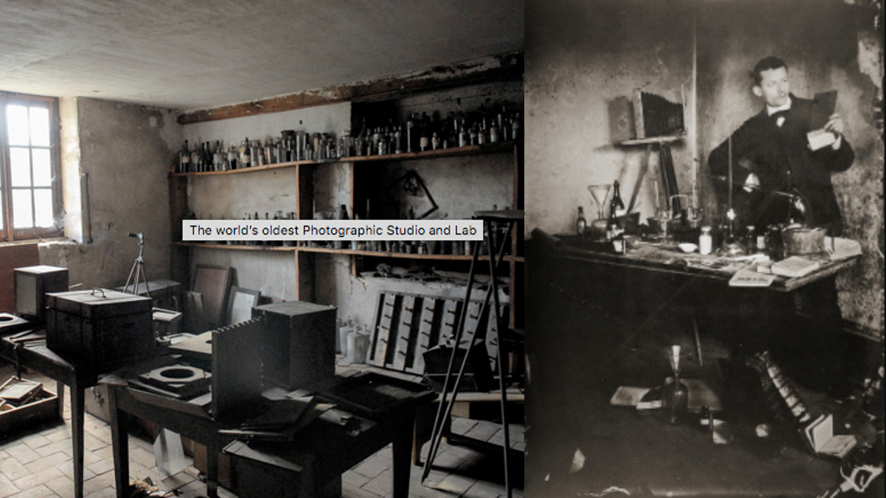

Slide 6
